Slide 1
Overton High School
Thursday, January 23, 2025 - 6:00 PM / OHS Cafeteria
Dr. Reginald Williams, Principal / williamsrr@scsk12.org

Slide 2
Wednesday, January 29
State of the District
Brunch and Learn 12:30pm – 2:00pm
Streamed Live

Slide 3
STATE OF THE SCHOOLS Overton HS Agenda
Welcome
Overview of Goals for SY24-25
Data to Highlight
Student Enrollment & Demographics Data
C.O.M.E. to Win/Attendance data
TVAAS
School Letter Grade/School Designation
2024 TCAP data and 2025 TCAP/AMO goals
2024 CCR/Ready Graduate/Graduation Data
2024 ACT data
Foci for Spring 2025

Slide 4
TSIP Goals for 2024-2025
Math and English Language Arts Goals
Goal 1: OHS will increase proficiency rates in ELA from 32.7% in 2023-2024 to 35.7% or higher in 2024-2025.
Goal 2: OHS will increase proficiency rates in Math from 9.8% in 2023-2024 to 12.8% or higher in 2024-2025.

Slide 5
TSIP Goals for 2024-2025
College & Career Readiness
(ACT, Ready Graduate, EPSO’s, CTE/Concentrators & Graduation Rate)
Goal 3: OHS will increase the percent of students meeting Ready Graduate Status from 11.3% in 2023-2024 to 14.3% or higher in 2024-2025.

Slide 6
TSIP Goals for 2024-2025
Climate and Access
(ESL, Chronic Absenteeism, and Discipline)
Goal 4: OHS will decrease chronic absenteeism rates from 38.0% in 2023-2024 to 35.0% or lower in 2024-2025.

Slide 7
Student Enrollment and
Demographics Data
Grade Level | Total in Grade |  | Asian | Black/ Afr. Amer. | Hispanic or Latino | Amer. Indian | Multiple Races | White | Unclassified
9 | 388 |  | 1 | 163 | 205 | 1 | 7 | 11 | 0
10 | 360 |  | 2 | 153 | 192 | 0 | 6 | 7 | 0
11 | 373 |  | 2 | 178 | 175 | 0 | 9 | 9 | 0
12 | 293 |  | 1 | 147 | 126 | 1 | 5 | 13 | 0
Total | 1414 |  | 6 | 641 | 698 | 2 | 27 | 40 | 0
Current Enrollment 1414
Grade Level | Special Ed. | ELL
9 | 50 | 121
10 | 34 | 103
11 | 30 | 65
12 | 32 | 50
Total | 146 (11%) | 338 (47.41%)

Slide 8
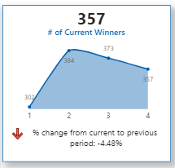
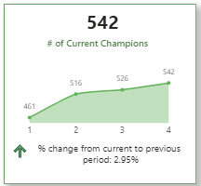
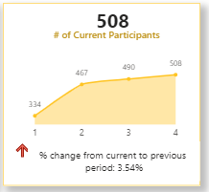
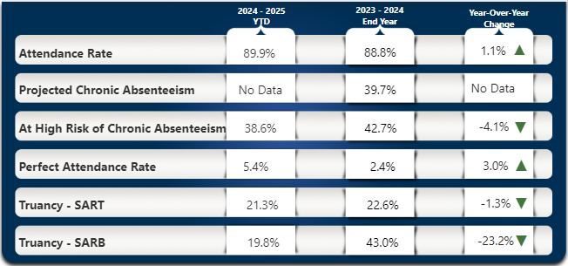
C.O.M.E. to Win/Attendance Data
7648 UNEXCUSED absences to date
7339 TARDIES
to date

Slide 9
TVAAS
(Tennessee Value-Added Assessment System)
Course | 2019-COVID | 2021- COVID | 2022 | 2023 | 2024
English I | 3 | 3 | 2 | 1 | 3
English II | 3 | 3 | 5 | 5 | 5
Algebra I | 1 | 1 | 1 | 1 | 1
Algebra II | 1 | 1 | 1 | 3 | 1
Geometry | 4 | 1 | 1 | 3 | 1
Biology |  | 4 | 3 | 4 | 5
U.S. History | 5 | 4 | 1 | Not offered | Not offered

Slide 10
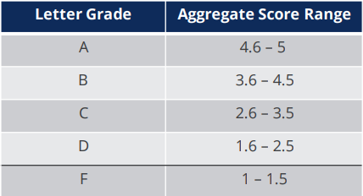
School State Letter Grade
(School designation)
Year | Letter Grade | Score | MSCS designation
22-23 | D | 2.3 | Supe School
23-24 | C | 2.8 | Ignite School

Slide 11
2023-2024 AMO Goals
EOC Course | 2022-2023 MET+EXCEED |  | OHS 2023-2024 AMO | OHS 2023-2024 Double AMO | 2023-2024 # students For Double AMO
ENGLISH
English I | 16.4% |  | 21.6% | 26.9% | 90 students
English II | 32.6% |  | 36.8% | 41.0% | 175 students
MATH
Algebra I | 3.2% |  | 9.2% | 15.3% | 61 students
Algebra II | 6.0% |  | 11.9% | 17.8% | 59 students
Geometry | 9.3% |  | 14.9% | 20.6% | 91 students
BIOLOGY | 19.5% |  | 24.6% | 29.6% | 110 students

Slide 12
College & Career Readiness
2022-2023 | 2023-2024
2 | 4

Slide 13
Ready Graduate
2022-2023 | 2023-2024
25.9% | 29.5%

Slide 14
Graduation Rate
2022-2023 | 2023-2024
76.0% | 83.5% Met Double AMO

Slide 15
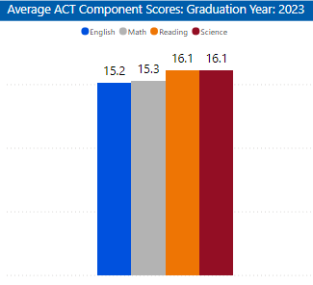
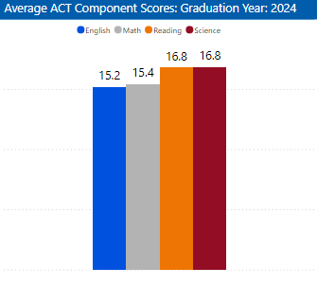
ACT

Slide 16
Focus for the Spring 2025

